Slide 1

Debug Entity Online Cloud Compiler (ONCC) Sprint 6 Presentation
Anchal Singh
Tushar Rakholiya
Sanath Gholap
Brandon Mercado
Ramesh Kyasaram
Harshada Chaudhari

Slide 2
Agenda
About our Project
Recap of Sprints 1-5
New Technologies
Sprint 6
Product Backlog
Retrospectives

Slide 3
About ONCC
ONCC is an Online Cloud Based Compiler for various programming languages.
User can select the programming language of their choice and compile his/her code using compiling modules created and tested in Python Flask.
Our project currently supports compilation of Java and Python language-based codes.
It is not necessary to login and register to use this compiler. But if a user wants to use feature like saving the code for future use or references, then the user must register and create an account.

Slide 4

Persona 1
PICTURE & NAME | DETAILS | GOAL
Name: Dan William Age: 24 Designation: Student | Role: Student Dan is a Student at Pace University. As an Information Technology student, he is struggling to learn and practice at least two most demanding computer languages so that he can prepare for his interviews to crack coding assessments by practicing his skills at a single platform which is available online where he can write, test and save his code without wasting extra memory space of his computer and save time as well. He can subscribe an online compiler platform, write, save and share the codes for future use. | He wants to get rid of installing multiple IDE’s and save his time to practice his coding skills for the assessment tests. Also, he wants to save it for later use.

Slide 5

Persona 2
PICTURE & NAME | DETAILS | GOAL
Name: Ethan Coufal Age: 30 Designation: Software Developer | Role: Software Developer Ethan is an independent mother of her single child. She is a struggling software developer working from home. She has to code in java as well as she has got a task to learn python from her company. But she barely has time to download multiple IDEs to learn, test and save her code simultaneously by keeping in mind the storage space of her computer. | She needs a single platform where she can write, test and save her code without wasting the memory of her PC. So that, she can save the time and access her code for long term by saving the code.

Slide 6

Persona 3
PICTURE & NAME | DETAILS | GOAL
Name: John McCarthy Age: 27 Designation: Student | Role: Student John is a student at Pace University. Being a Graduate student in Computer Science, writing and compiling codes in different languages is part of his daily life. Sometimes, He finds it difficult to get the subscription for different IDEs because it’s costly and time consuming. It will become more costly if he will take subscription for all different IDEs for each coding languages. Therefore, he yearns for a single platform where he can compile, run and save time at least more frequently used languages (Java, Python, C#, C, C++) at the same platform by making the coder’s life easier. | He wants a different compiler at single platform, where he can compile at least more frequently used languages (Java, python, C#, C/C++) to make his coding life easier and save time.

Slide 7
Recap of Sprints 1-5
Learned and Developed flask web application.
Created registration/login page.
Created drop-down menu for C, C++, C#, Java and Python.
Developed Compiler modules for Java and Python Programming languages.
Created MongoDB database for user login and registration.
Aggregation of the Tables for saving code to specific user.
Aggregation of the Tables for sharing code.
Researched and finalized AWS cloud platform.
Onboarded whole team on AWS platform.
Integration of DynamoDB on AWS.
Hosted a Web Application on AWS cloud for user’s convenient accessibility.

Slide 8



New Technologies
AWS- Hosting our project on the cloud with AWS enables us to build, deploy and manage our website with reliability and redundancy.
AWS IAM- Security roles
AWS Authy- Authy is an application we use for Multi-factor Authentication. Authy the mobile application will send you a 6-digit token, when typed into the console proper will enable you to login to the AWS Services.
boto3- In order to configure, create and manage AWS services such as Amazon Elastic Cloud (EC2) and Amazon Simple Storage Services (S3), we are using the AWS SDK for python which is know as boto3.
DynamoDB- A fully managed proprietary NoSQL database that allows us flawless accessibility and seamless scalability.

Slide 9
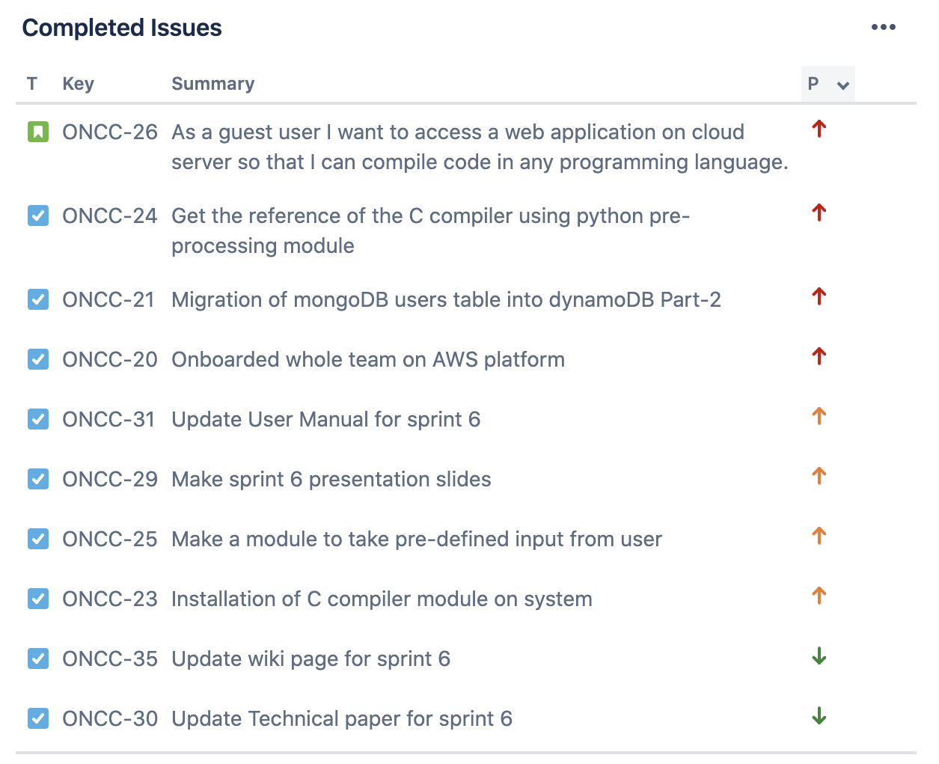
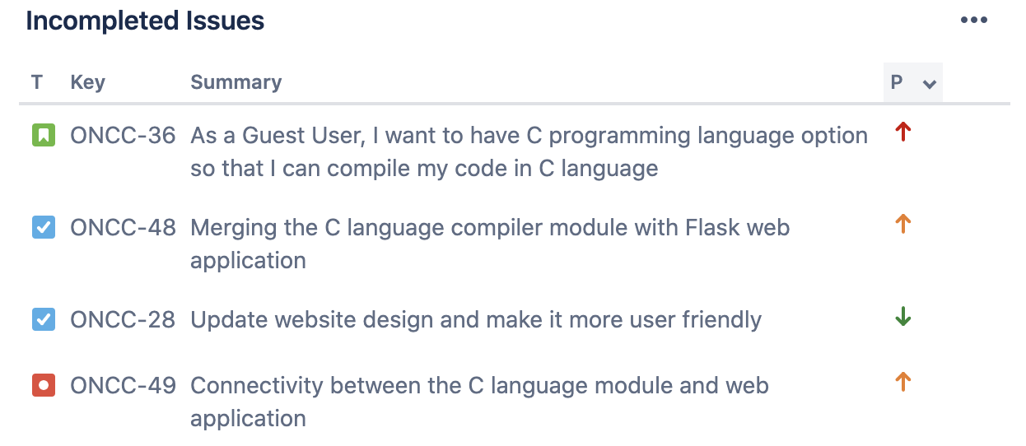
Sprint 6 Report
In this sprint, we couldn’t be able to complete the highlighted story because it is blocked by the bug.

Slide 10
Acceptance Criteria
Key | Summary | Label
ONCC-26 | Given that being a Guest User, I want to have a web application that should display multiple options of programming language, So that I can compiler program in any chosen programming language. | Cloud Access
ONCC-36 | Given that being a Guest User, I want to have the options to choose a programming language i.e., C, So that I can write and compile the code in C programming. I want to compile the code in C language, So that I can get the desired output, or it should display error. I want to have an input field to enter the predefined input for the code. I want compiler to take the input from the input field and compile code with pre-defined input | Compiler

Slide 11
Test cases
Test Cases for | Key | Steps | Test Cases | Test Data | Expected Results | Actual Results | Status
Cloud access | ONCC-26 | 1 | Options available for C compiler in drop-down menu | Selecting C option from drop-down menu | C compiler will be selected and “Write code in C language here” placeholder will be displayed in the text area | C compiler is selected and “Write code in C language here” placeholder is displayed in the text area | PASS
Compiler | ONCC-36 | 1 | Writing and compiling the code in C language. | Enters the code in C language and click on Run button | Code should be compiled successfully and get the desired output or errors | No output or error message displayed | FAIL
 |  |  |  |  | Code is not successfully compiled and shows error | No output or error message displayed | FAIL
 |  | 2 | Compiling empty code | Click on Run button without writing code | Will show error for empty code in error field | No error message displayed | FAIL
 |  | 3 | Running test code in python pre-processing module | Entering C code in pre-processing module | Getting desired output in String variable | Got output in the String variable | PASS
 |  |  |  |  | Getting expected error in Error variable if code is wrong | Got desired error in the Error variable | PASS
 |  |  |  |  | Entering Predefined Input for the code to compile with input | Accepting input for written code and compiling with the input | PASS
 |  | 4 | Entering Predefined input | Entering input in the input field for the compilation of code with input parameter | Taking input from input field and adding it into the code | No output | FAIL
 |  |  |  |  | Showing input missing when the field is empty when required | No Output | FAIL

Slide 12
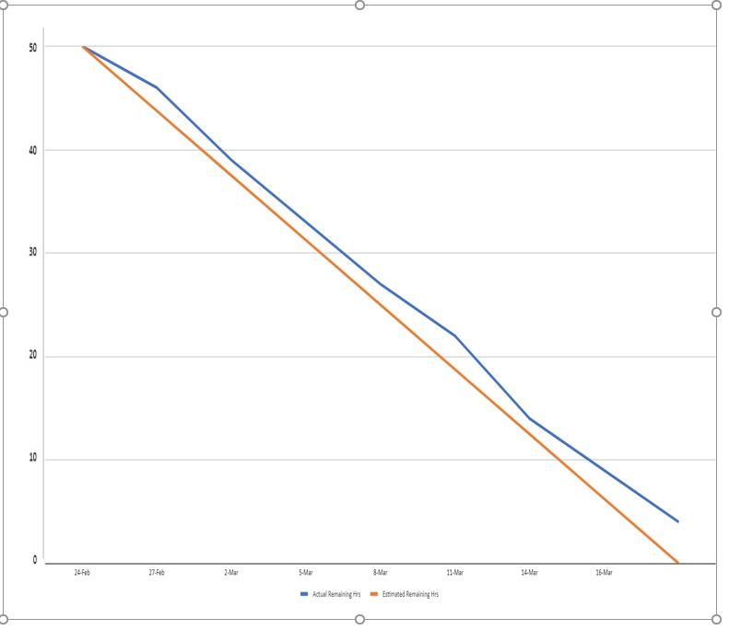
Sprint 6 Burndown Chart

Slide 13
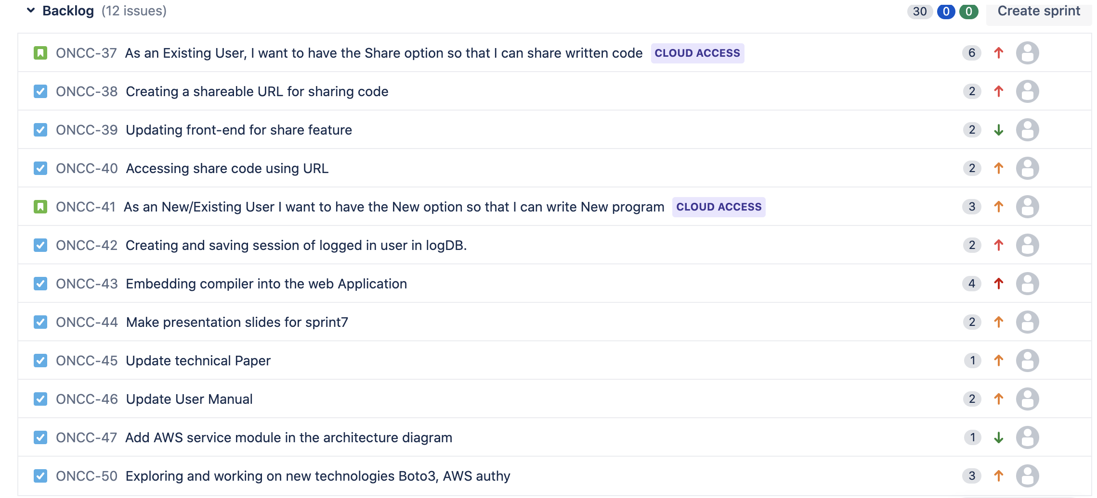
Product Backlog

Slide 14
Sprint 7 Planned Stories
Issue Type | Key | Summary | Priority | Status
Story | ONCC-37 | Save/Share options page | Highest | To-do
Story | ONCC-41 | New options page for new program | Medium | To-do

Slide 15
Moving forward in this semester…
Adding more functionality, after user selects a particular language, a pop message should display in the source code area saying, “you can write your code in java/python/C++”.
Adding share button to share the source code.
Adding save button to save the source code.
Creating and saving a session of user’s login activity.
Embedding compiler into the web application.
Learning Dockers and using it for making multiple language containers.

Slide 16
Retrospectives
What went well
Successful frequent meetings and teamwork .
Meetings, and documentation works.
Successfully worked with Jira tool
What needs improvement
Need more focused and comprehensive planning to avoid mid sprint tasks and good traceability on Jira.
Explore and learn services provided by AWS i.e., Boto3, AWS authy
Secret key issues python flask development.
Next Steps
Connectivity between the C language compiler and web application.
Developing a language module for C# compiler.

Slide 17



GitHub Link
https://github.com/sg99356n/OnlineCC/wiki

Slide 18
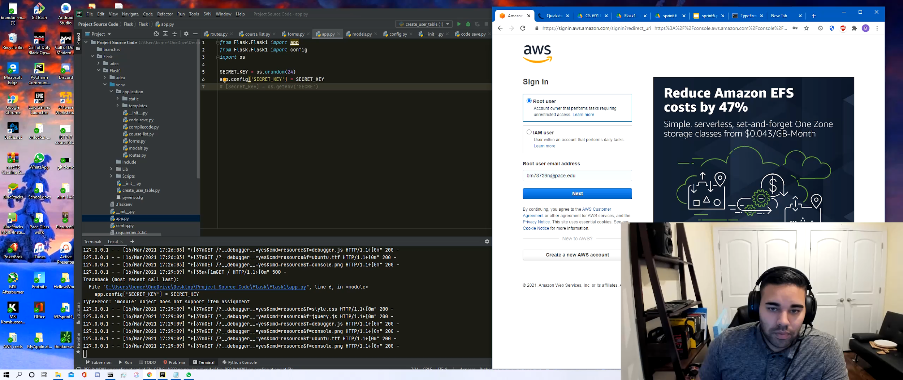
Demo

